Slide 1


What have you learned this term?

Slide 2
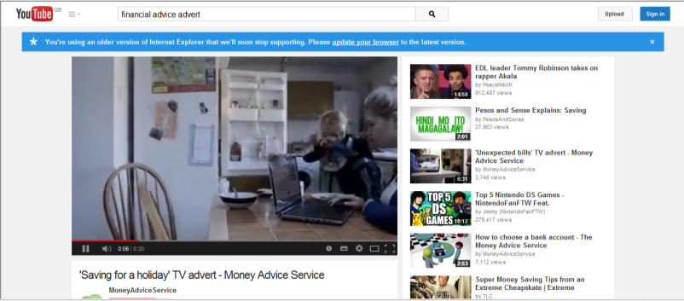
Watch this advert!

Slide 3
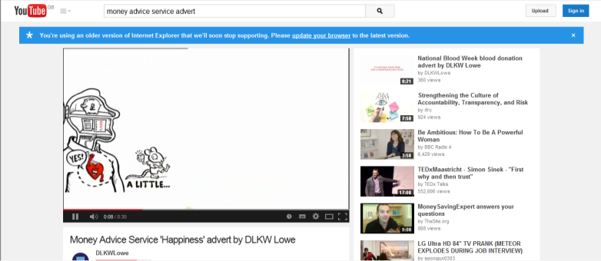
Watch this clip!

Slide 4
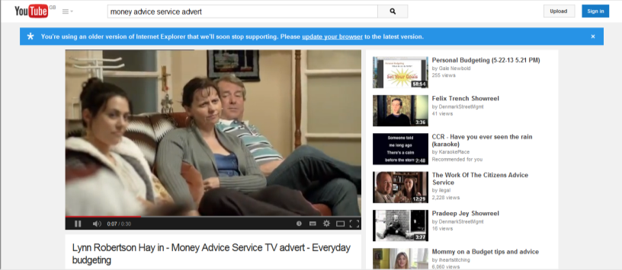
Watch this clip!

Slide 5

Your task
In groups of 3 are going to produce a financial advice advert for the TV or radio.
Your TV or radio adverts include:
A Script
Sound effects
Information on different financial areas learnt from lessons
A style which clear, unique and applies to all age groups!
Or any other ideas you have!

Slide 6


Slide 7

You have 20 minutes to prepare your adverts!

Slide 8

Let’s watch your Adverts!

